Slide 1
React Js
Components

Slide 2
What is React Js?
React is a free and open-source front-end Javascript library for building user interfaces baseed on components.
Current Version:18.2.0

Slide 3
What are Components in React Js?
Components in React are used to divide a user interface into independent components that can be handled easily and are reusable.
Components comes in two types:
1.Class Components.
2.Function Components.

Slide 4
Class Components:
Before React 16.8, class components were frequently used in React projects. The reason is that in function components, you cannot track the state and lifecycle methods of the component. The function components were known as “state-less” components.
To track the state of the components and use lifecycle methods, we have to use the class components in React.

Slide 5
Class Component Syntax:
To implement a class component, use the keyword ‘class’ before the name of your class component and extend it with the component class.
import React, { Component } from 'react'
class New extends Component {
render() {
return (
<h1>Hello World</h1>
)
}
}
export default New

Slide 6
Function Components
These are simply JavaScript functions. We can create a functional component in React by writing a JavaScript function. These functions may or may not receive data as parameters. In the functional Components, the return value is the JSX code to render to the DOM tree.
Before React 16.8, function components did not have state or lifecycle hooks.
With the Use of React Hooks we can manage States in Function Components without Creating Class Components

Slide 7
Function Component Syntax:
A Function component also returns HTML, and behaves much the same way as a Class component.
Syntax:
function App() {
return <h2>Hello World!</h2>;
}
export default Car;

Slide 8
Diff b/w Class and func components
Functional Components | Class Components
A functional component is just a plain JavaScript pure function that accepts props as an argument and returns a React element(JSX). | A class component requires you to extend from React. Component and create a render function that returns a React element.
Function components can be written using much less code, are easier to understand, and will be preferred in this tutorial. | Class components can be difficult to understand compared to function components.
Hooks can be easily used in functional components to make them Stateful. | You can't use Hooks inside a class component.
Constructors are not used. | Constructor is used as it needs to store state.

Slide 9
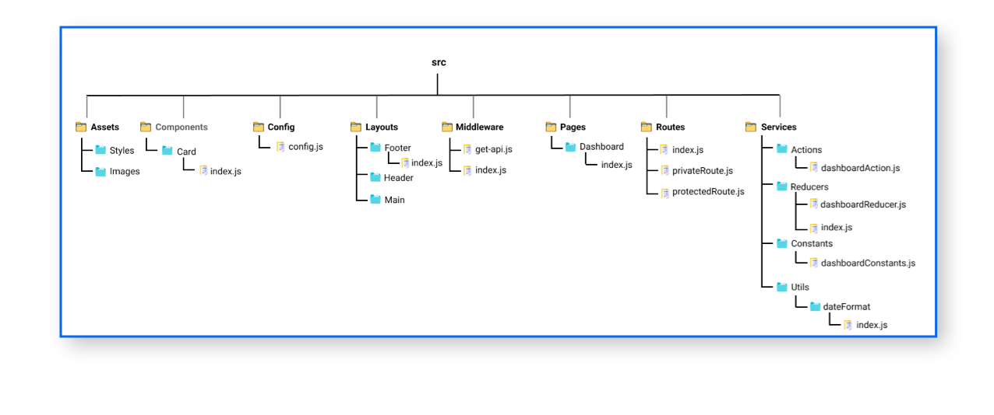
Folder Structure for React Project

